Slide 1
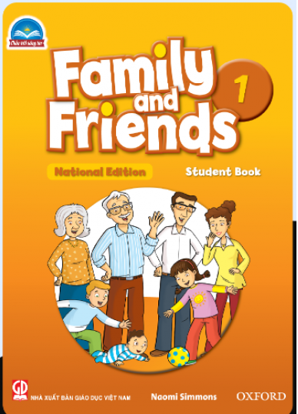
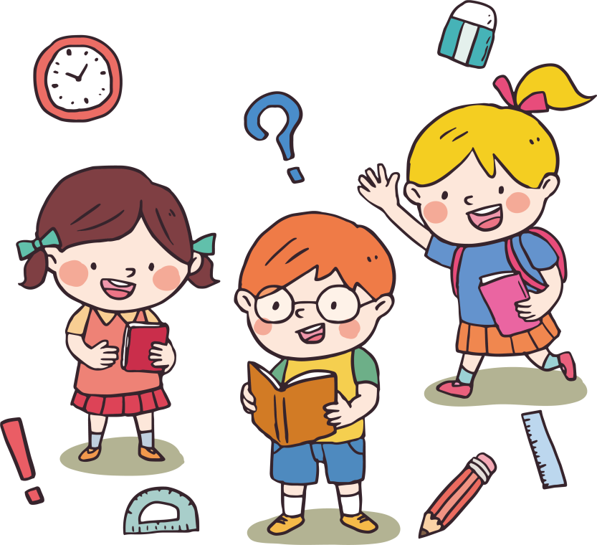
FAMILY &FRIENDS 1
National Edition

Slide 2
UNIT 6: LUNCHTIME!
LESSON 4 : NUMBERS

Slide 4
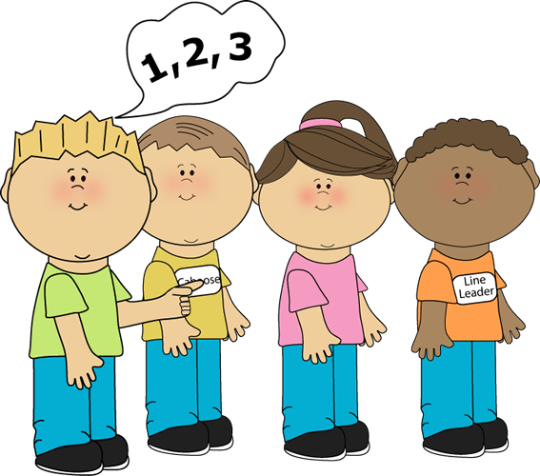
RE-ORDER
GAME
Notes:
- Ask ten students to come to the front and stand in a line.
- They each call out the numbers 1 to 10 in order.
- The rest of the class points to each student and gives them a different number (from 1 to 10).
- The ten students put themselves into order and they call out their new number. Repeat with other students

Slide 5
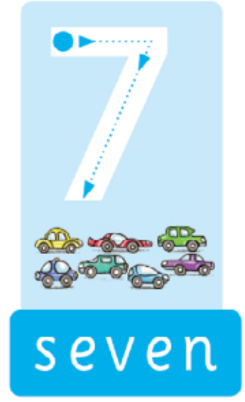
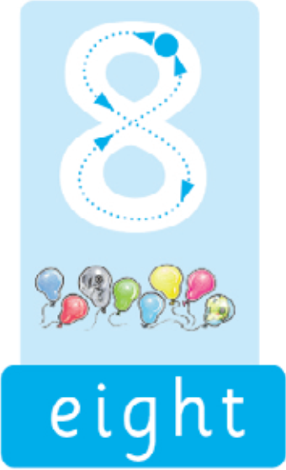
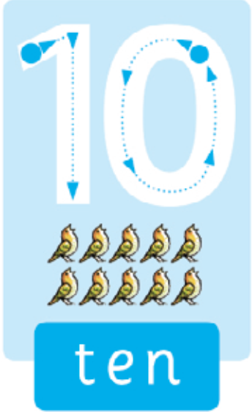
Notes:
Listen, point, and repeat. Write. Track 80
- Play the track and point to the pictures.
- Play the track again and point to the words.
- Encourage the students to copy you.
- Play the track several times for the students to practice repeating the numbers.
- Finally, model the writing activity.

Slide 6
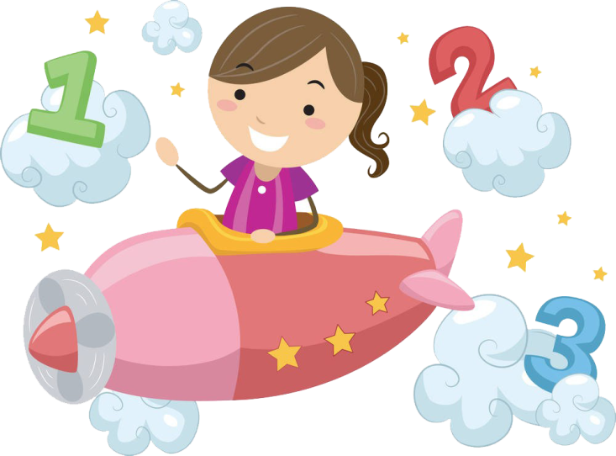
Match and say
Notes:
Match and say.
- Point to the number words and ask students to follow them while you read each one.
- Repeat and ask students to say the words with you.
- Point to the number 6 above, and say Six. Say: Let’s match!
Match it with the word six.
- Repeat with the other numbers and words. Students match and say the numbers.

Slide 7
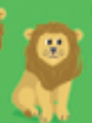
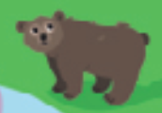
Count, circle, and say.
Notes:
Count, circle, and say.
Point to the word lions and say How many lions?
Circle each lion one at a time and count. Encourage the students to count and circle with you. Say six lions.
Repeat with the birds, hippos, and bears.

Slide 8
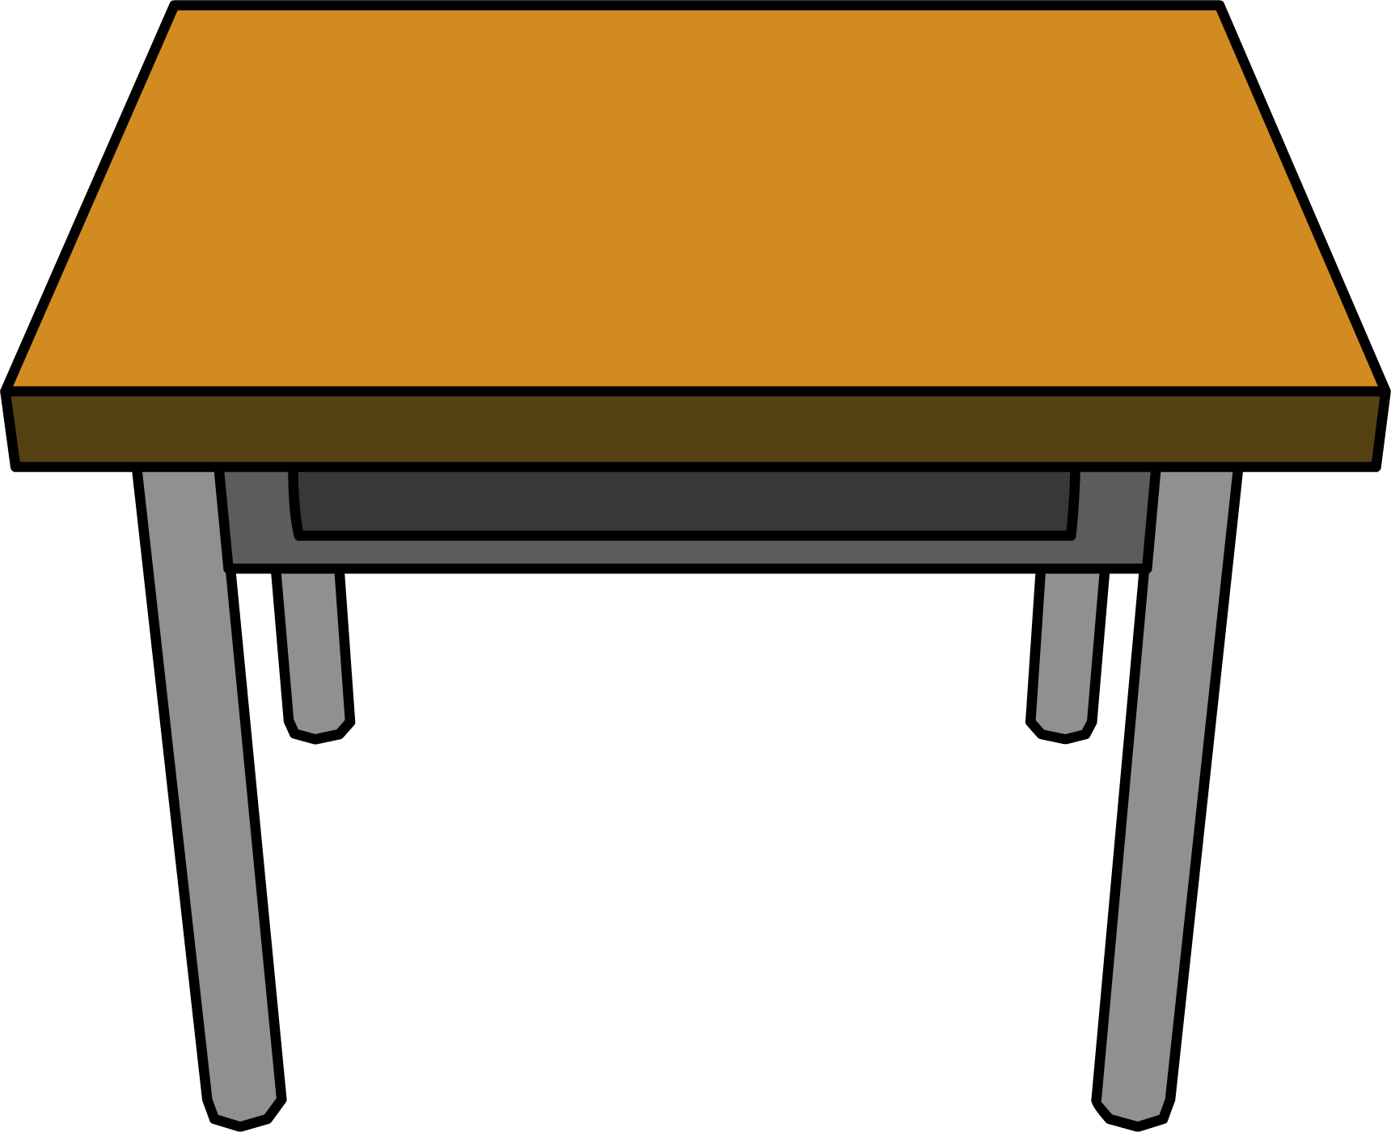
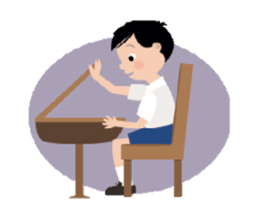
What’s in your desk ?
Count and say
Notes:
What’s in your desk? Count and say.
- Point to the smaller pictures, eliciting the words from the class. Point to the bigger picture and say What’s in your desk?
- Demonstrate the activity with a student’s desk and hold up and count the pencils, crayons, and books. Encourage the students to count along with you.
Below level: Demonstrate Exercise 4 several times, before calling on individuals to count and say what is in his/her desk.
At level: Call on individuals to count and say what is in his/her desk before putting students in pairs to talk to each other about their desks.
Above level: Repeat Exercise 4 with students working in pairs. Have them change partners for further practice.
Ask students to draw their desk with the pencils, crayons, and books inside, and to write the correct number next to each item.

Slide 9
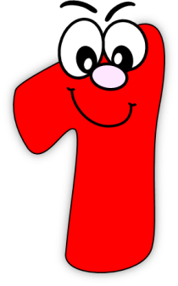
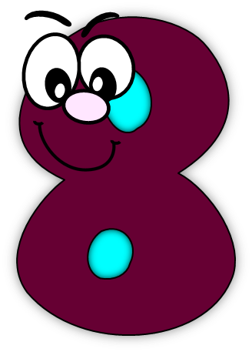

Slide 10
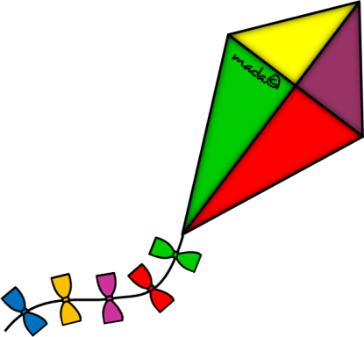
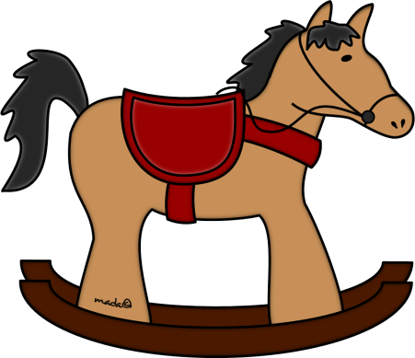
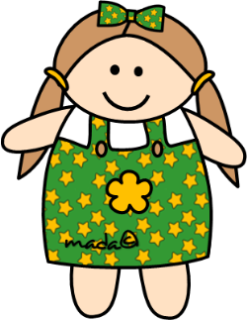
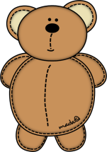
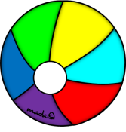

Slide 11
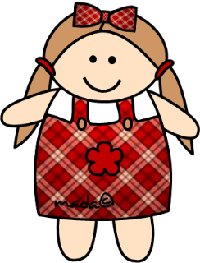

Slide 12
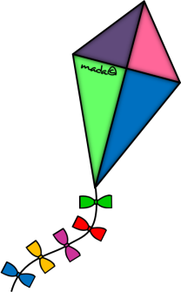
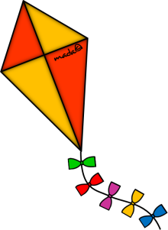
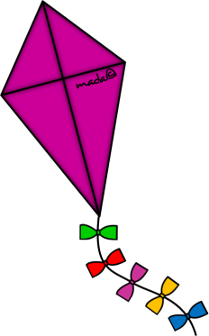
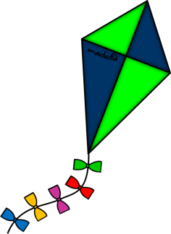
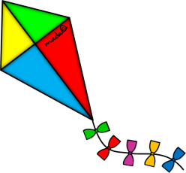

Slide 13
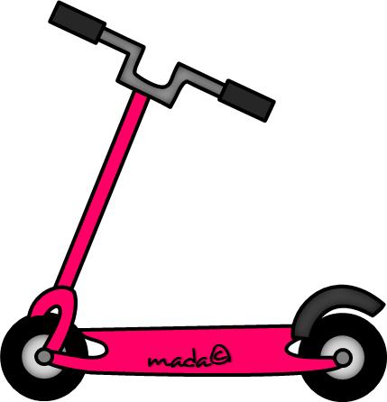
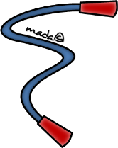

Slide 14
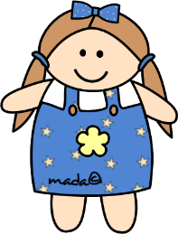

Slide 15
Goodbye !

